Slide 1
Expert System for predicting employee attrition rate in Organizations Presented By: Nilesh Kumar Sahu

Slide 2
Abstract
Predicting reliability of an employee in an organization is much needed.
It is useful for various tasks such as conferring hikes, giving benefits and predicting how long an employee is planning to stay in company.
Currently, it is referred to as Employee attrition and is the major cost affecting an organization largely.

Slide 3
Abstract
Till date, the work done in this field include different approaches like Logistic Regression, classification whether ‘Yes’ or ‘No’.
Our work focus on an expert system that tries to predict the employee attrition rate in organizations using Deep Neural Network.
We put forth a methodology of how to predict reliability of an employee in an organization.
This expert system can help the organization to minimize their loss and could have good understanding of workforce supply and demand

Slide 4
Introduction
Today, attrition is one of the important issues in an organization. Employees' liking for an organization depends on several factors[1,2,3].
The Barron’s Business dictionary defined attrition as the normal and uncontrollable reduction of a work force because of retirement, death, sickness, and relocation [4].
Attrition depends on varied factors such as inadequate wage levels, poor morale, low levels of motivation within the group, better opportunities elsewhere; current organization is inadequate, and lack of personal development.

Slide 5
Introduction
The exodus of employees impacts the organizations as they carry with them invaluable unstated knowledge which becomes an advantage for the competitors.
Specifically, this is categorized as either voluntarily or involuntarily in an organization's employees voluntarily leaving may be attributed to the work environment, dissatisfaction in job scope, compensation personal growth, challenges and are an important metric to predict the attrition.
Involuntary, on the other hand, depends more on poor performance, restructuring of organization and certain uncontrollable factors like retirement, dismissal or death.

Slide 6
Introduction
But in some cases, an organization fires the employee for committing mistakes or slackness in job or may be due to other circumstances.
Several other features, such as working conditions[4-5], job satisfaction, and growth potential also contributed to voluntary attrition[5-6].
Predicting the turnover also depends on this factor and has become one the major need of Human Resources (HR) in most organizations.
We use evaluation of employee performance, average monthly hours at work and number of years spent in the company, among others, as our features[6-7]

Slide 7
Introduction
Within a company, much data is available to help develop an effective retention management plan[8].
To create a sound plan, there is a need to determine the extent to which turnover is a problem in the firm, diagnose turnover drivers, and formulate retention strategies[9].
Additionally, the Human Resource (HR) management systems have records of all job status changes, including voluntary terminations, employee’s job-action history, the length of time in a position, and salary history[10].

Slide 8
Introduction
This large collection of employee data within an organization, especially that possessed by the Human Resource (HR) division of the organization can be analyzed for the effective prediction of employee attrition.
Data mining[11]can be helpful to human resources departments in identifying the characteristics of their most successful employees, most especially aid in figuring out employee with high attrition (turnover) potentials. Information obtained,[12]such as universities attended by highly successful employees, can help Human Resource (HR) departments[13]focus recruiting efforts accordingly.
Our expert system is also trying to predict the employee attrition rate on the basis of given different parameters using Deep Neural Networks.

Slide 9
Related Work
Literary works show the adoption of decision tree models and rule sets for predicting employee attrition[1].
Machine learning can play an important role in predicting employee attrition and taking managerial decisions proactively.
Their results confirm that the replacement of a skilled employee is both time consuming and challenging.
Most literary work done in this field include different approaches like Logistic Regression , classification whether ‘Yes’ or ‘No

Slide 10
Related Work
Our work presents, in addition, an expert system that tries to predict the employee attrition rate in organizations using Deep Neural Network.
Different metrics on the training set can be used to see how a model is progressing in terms of it's training, and it's metrics on the validation set enables us to get a measure of the quality of chosen model as to how well it's able to make new predictions based on data it hasn't seen before.

Slide 11
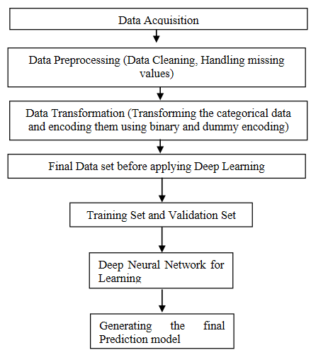
Proposed Methodology
Block diagram of proposed work

Slide 12
A. Dataset Acquisition
Employee attrition depends upon many factors from growth rate to work life balance of an employee.
Here I have considered some of the factors which will be playing an important role in predicting the employee attrition.
This can also be discussed with HR team of an organization for better understanding of employee data

Slide 13
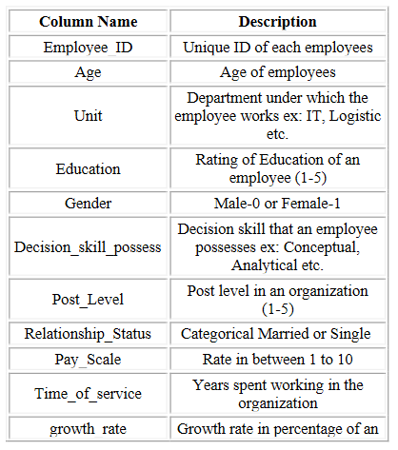
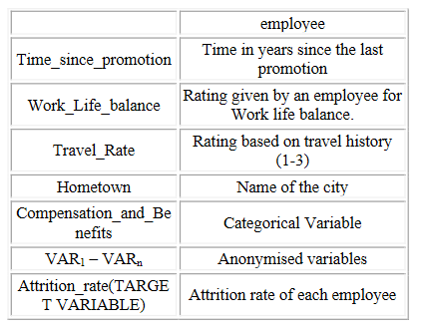
A. Dataset Acquisition
Features considered while solving this problem where anonymized variable were dropped to generalize our model.

Slide 14
B. Data Preprocessing
Missing values requires special attention before applying any learning algorithm[19].
There are many different ways to handle the missing and the most common tool is to drop those data points which consist of missing values but dropping them will lead to loss of information too. So, we have use Median to replace the missing value of a particular column[20].
The point here is to be noted that this Median technique can only be applied with the numerical attribute. Age and Education Level were only such attribute which consist of missing values so we have applied Median to impute the missing values[21-22].

Slide 15
B. Data Preprocessing
Since Machine Learning is a mathematical tool, we need to encode the non-numerical values.
Binary encoding was used to encode attributes like Gender and Relationship Status as they consist of only two states in the dataset, while dummy encoding was used to encode attributes, Unit, Decision Skill process and compensation and benefits [18]

Slide 16
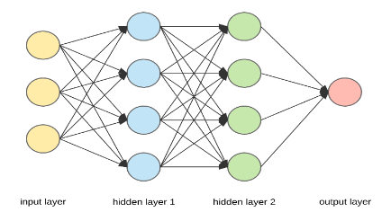
C. Deep Learning
Deep Learning is an Artificial Neural Network with multiple numbers of layers with input and output as shown in figure above. Different optimizer and evaluation method like mean squared error can be used to evaluate the model.

Slide 17
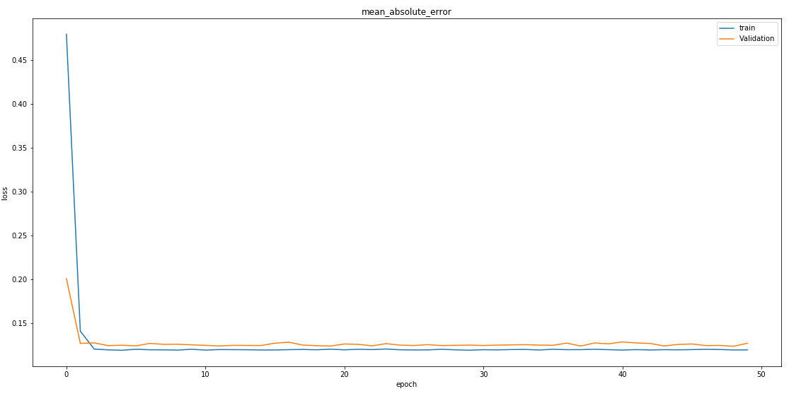
Results and Conclusion
loss: 0.1197 and val_loss: 0.1273, Mean Absolute Error plot

Slide 18
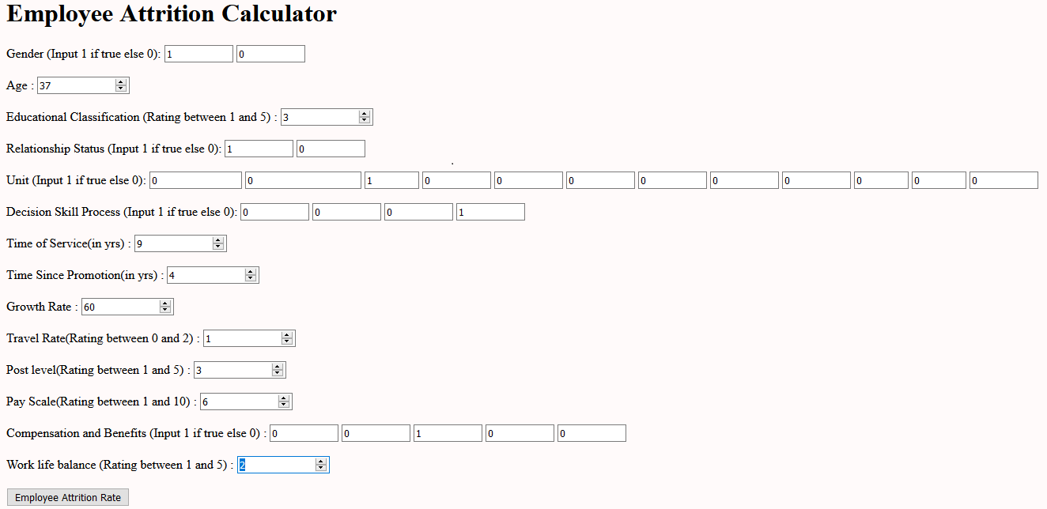
Results and Conclusion (Example)

Slide 19
Results and Conclusion (Example)
For the above input data our model predicted :
90% probability is that the employee is not going to leave the organization.

Slide 20
References
[1]Mohbey, K. K. (2020). Employee's Attrition Prediction Using Machine Learning Approaches. InMachine Learning and Deep Learning in Real-Time Applications(pp. 121-128). IGI Global.
[2]Ponnuru, S. R., Merugumala, G. K., Padigala, S., Vanga, R., & Kantapalli, B. Employee Attrition Prediction using Logistic Regression.
[3]Ballal, I., Kavathekar, S., Janwe, S., Shete, P., & Bhirud, N. (2020). People Leaving the Job–An Approach for Prediction Using Machine Learning.IJRAR-International Journal of Research and Analytical Reviews (IJRAR),7(1), 891-893.
[4]Alao, D. A. B. A., & Adeyemo, A. B. (2013). Analyzing employee attrition using decision tree algorithms.Computing, Information Systems, Development Informatics and Allied Research Journal,4(1), 17-28.
[5]Aswale, N., & Mukul, K. (2020). Role of Data Analytics in Human Resource Management for Prediction of Attrition Using Job Satisfaction. InData Management, Analytics and Innovation(pp. 57-67). Springer, Singapore.
[6]Ramalakshmi, E., & Kamidi, S. R. (2019, January). Prediction of Employee Attrition and Analyzing Reasons: Using Multi-layer Perceptron in Spark. InInternational Conference on Intelligent Computing and Communication Technologies(pp. 183-192). Springer, Singapore.
[7]Karande, S., & Shyamala, L. (2019). Prediction of Employee Turnover Using Ensemble Learning. InAmbient Communications and Computer Systems(pp. 319-327). Springer, Singapore.

Slide 21
References
[8]Alduayj, S. S., & Rajpoot, K. (2018, November). Predicting employee attrition using machine learning. In2018 International Conference on Innovations in Information Technology (IIT)(pp. 93-98). IEEE.
[9]Yadav, S., Jain, A., & Singh, D. (2018, December). Early Prediction of Employee Attrition using Data Mining Techniques. In2018 IEEE 8th International Advance Computing Conference (IACC)(pp. 349-354). IEEE.
[10]Yedida, R., Reddy, R., Vahi, R., Jana, R., GV, A., & Kulkarni, D. (2018). Employee Attrition Prediction.arXiv preprint arXiv:1806.10480.
[11]Shankar, R. S., Rajanikanth, J., Sivaramaraju, V. V., & Murthy, K. V. (2018, July). Prediction of Employee Attrition Using Datamining. In2018 IEEE International Conference on System, Computation, Automation and Networking (ICSCA)(pp. 1-8). IEEE.M. Young, The Technical Writer’s Handbook. Mill Valley, CA: University Science, 1989.
[12]Sisodia, D. S., Vishwakarma, S., & Pujahari, A. (2017, November). Evaluation of machine learning models for employee churn prediction. In2017 International Conference on Inventive Computing and Informatics (ICICI)(pp. 1016-1020). IEEE.
[13]Valluru, S. (2018). Turnover Analytics & Forecasting Hiring Demand: HR Domain.International Journal of Business Insights and Transformation,12(1), 3-5.
[14]Ajit, P. (2016). Prediction of employee turnover in organizations using machine learning algorithms.algorithms,4(5), C5.

Slide 22
References
[15]Barvey, A., Kapila, J., & Pathak, K. (2018). Proactive intervention to downtrend employee attrition using artificial intelligence techniques.arXiv preprint arXiv:1807.04081.
[16]Prediction of Employee Turnover in Organizations using Machine Learning Algorithms A case for Extreme Gradient Boosting Rohit Punnoose, Pankaj Ajit, (IJARAI) International Journal of Advanced Research in Artificial Intelligence, Vol. 5, No. 9, 2016.
[17]Dutta, S., & Bandyopadhyay, S. K. Employee attrition prediction using neural network cross validation method., International Journal of Commerce and Management Research, Volume 6; Issue 3; 2020; Page No. 80-85
[18]Latha, K. L. (2013). A study on employee attrition and retention in manufacturing industries.BVIMSR’s Journal of Management Research (BJMR),5(1), 1-23.
[19]Srivastava, D. K., & Nair, P. (2017, March). Employee attrition analysis using predictive techniques. InInternational Conference on Information and Communication Technology for Intelligent Systems(pp. 293-300). Springer, Cham.
[20]Raman, R., Bhattacharya, S., & Pramod, D. (2019). Predict employee attrition by using predictive analytics.Benchmarking: An International Journal.
[21]Setiawan, I., Suprihanto, S., Nugraha, A. C., & Hutahaean, J. HR analytics: Employee attrition analysis using logistic regression
[22]Alaskar, L., Crane, M., & Alduailij, M. (2019, December). Employee Turnover Prediction Using Machine Learning. InInternational Conference on Computing(pp. 301-316). Springer, Cham.

Slide 23
ThankYou!

